Slide 1

OPINION ANALYSIS BY USING ARTIFICIAL INTELLIGENCE IN SOCIAL MEDIA
Minor project-II report submitted
in partial fulfillment of the requirement for award of the degree of
Bachelor of Technology in
Computer Science & Engineering
By
RAYALA SRIHARI | (21UECS0525) | (VTU20285)
K NAGARAJU | (21UECS0307) | (VTU20286)
D DEEPANKAR | (21UECS0134) | (VTU20311)
Under the guidance of
Mr.S.GOPI,,M.Tech., ASSISTANT PROFESSOR
DEPARTMENT OF COMPUTER SCIENCE & ENGINEERING SCHOOL OF COMPUTING
VEL TECH RANGARAJAN DR. SAGUNTHALA R&D INSTITUTE OF SCIENCE & TECHNOLOGY
(Deemed to be University Estd u/s 3 of UGC Act, 1956) Accredited by NAAC with A++ Grade CHENNAI 600 062, TAMILNADU, INDIA
May, 2024

Slide 2
OPINION ANALYSIS BY USING ARTIFICIAL INTELLIGENCE IN SOCIAL MEDIA
Minor project report submitted
in partial fulfillment of the requirement for award of the degree of
Bachelor of Technology in
Computer Science & Engineering
By
RAYALA SRIHARI | (21UECS0525) | (20285)
K NAGARAJU | (21UECS0307) | (20286)
D DEEPANKAR | (21UECS0134) | (20311)
Under the guidance of Mr.S.GOPI,M.Tech., ASSISTANT PROFESSOR
DEPARTMENT OF COMPUTER SCIENCE & ENGINEERING SCHOOL OF COMPUTING
VEL TECH RANGARAJAN DR. SAGUNTHALA R&D INSTITUTE OF SCIENCE & TECHNOLOGY
(Deemed to be University Estd u/s 3 of UGC Act, 1956) Accredited by NAAC with A++ Grade CHENNAI 600 062, TAMILNADU, INDIA
May, 2023

Slide 3
CERTIFICATE
It is certified that the work contained in the project report titled ” ( OPINION ANALYSIS BY USING ARTIFICIAL INTELLIGENCE IN SOCIAL MEDIA ) ” by ” RAYALA SRIHARI ( 21UECS0525),
K NAGARAJU (21UECS0307), D DEEPANKAR (21UECS0134) ” has been carried out under my supervision and that this work has not been submitted elsewhere for a degree.
Signature of Signature of Supervisor
Computer Science & Engineering School of Computing
Vel Tech Rangarajan Dr. Sagunthala R&D Institute of Science & Technology
May, 2024
Signature of Professor In-charge
Computer Science & Engineering
School of Computing
Vel Tech Rangarajan Dr. Sagunthala R&D Institute of Science & Technology
May, 2024
i

Slide 4
DECLARATION
We declare that this written submission represents our ideas in our own words and where others ideas or words have been included, we have adequately cited and referenced the original sources. We also declare that we have adhered to all principles of academic honesty and integrity and have not misrepresented or fabricated or falsified any idea/data/fact/source in our submission. We understand that any violation of the above will be cause for disciplinary action by the Institute and can also evoke penal action from the sources which have thus not been properly cited or from whom proper permission has not been taken when needed.
RAYALA SRIHARI
Date: / /
K NAGARAJU
/ /
Date :
D DEEPANKAR
Date: / /
ii

Slide 5
APPROVAL SHEET
This project report entitled (OPINION ANALYSIS BY USING ARTIFICIAL INTELLIGENCE IN SOCIAL MEDIA) by ((RAYALA SRIHARI (21UECS0525), (K NAGARAJU (21UECS0307), (D DEEPANKAR(21UECS0134)) is approved for the degree of B.Tech in Computer Science & Engineering.
Examiners
Supervisor Mr.S.GOPI,M.Tech.,,.
Date: / / Place: Avadi, Chennai
iii

Slide 6
ACKNOWLEDGEMENT
We express our deepest gratitude to our respected Founder Chancellor and President Col. Prof. Dr. R. RANGARAJAN B.E. (EEE), B.E. (MECH), M.S (AUTO),D.Sc., Foundress President Dr.
R. SAGUNTHALA RANGARAJAN M.B.B.S. Chairperson Managing Trustee and Vice President.
We are very much grateful to our beloved Vice Chancellor Prof. S. SALIVAHANAN, for the providing us with an environment to complete our project successfully.
We record indebtedness to the our Professor & Dean, Department of Computer Science & Engineering, School of Computing, Dr.V.SRINIVASA RAO, M.Tech., Ph.D., for immense care and encouragement towards us throughout the course of this project.
We are thankful to our Head, Department of Computer Science & Engineering Dr. M. S. MURALIDHAR, M.E., Ph.D., for providing immense support in all our endeavors.
We also take this opportunity to express a deep sense of gratitude to our Internal Supervisor Mr.
S.GOPI, M.Tech. for him cordial support, valuable information and guidance, he helped us in completing this project through various stages.
A special thanks to our Project Coordinators Mr. V. ASHOK KUMAR, M.Tech., Ms. C. SHYAMALA KUMARI, M.E., for their valuable guidance and support throughout the course of the project.
We thank our department faculty, supporting staff and friends for their help, support and guidance to complete this project.
RAYALA SRIHARI
K NAGARAJU
D DEEPANKAR
(21UECS0525) (21UECS0307) (21UECS0134)
iv

Slide 7
ABSTRACT
The traditional manual methods for opinion analysis are time consuming and they are limited in their ability to handle large volumes of data. Artificial intelligence techniques, natural language processing and machine learning, have emerged as powerful tools for automating the process of opinion analysis in social media. The application of AI in an social media for opinion analysis. It discusses various AI techniques that are used for sentiment analysis, emotion detection, and topic extract and to gain insights into users opinions and attitudes. The benefits of AI-driven opinion analysis in social media. It emphasizes the ability of AI models to process vast amounts of data quickly, enabling real time analysis and providing valuable insights for businesses, marketers, policy makers. AI can help identify emerging trends, detect customer sentiment towards the products or services, and understand public opinion on social and political issues. The aim of our project is to analyse a solution for the perception classification at a fine grinded level, mainly the sentence level in which polarity of sentence can be given by three categories such as positive, negative and neutral.
Keywords: Support Vector Machine, Opinion, Positive, Negative, Neutral, Text Mining, Classification.
v

Slide 8
LIST OF FIGURES
Architecture Diagram of Opinion analysis using AI . . . . . . . 10
Activity Diagram of Opinion analysis using AI . . . . . . . . . . 11
Usecase Diagram of Opinion analysis using AI . . . . . . . . . . 12
Sequence Diagram of Opinion analysis using AI . . . . . . . . . 13
5.1 Input Design . . . . . . . . . . . . . . . . . . . . . . . . . . . . . 16
5.2 Output Design . . . . . . . . . . . . . . . . . . . . . . . . . . . . 17
Input of opinion analysis using AI . . . . . . . . . . . . . . . . . 18
Output of opinion analysis using AI . . . . . . . . . . . . . . . . 19
Integration testing input for airline . . . . . . . . . . . . . . . . 20
Integration testing output for airline tweets . . . . . . . . . . . . 20
Implementation of system input . . . . . . . . . . . . . . . . . . 21
Reviews for particular Airlines . . . . . . . . . . . . . . . . . . . 21
Shows the Airline Reviews 24
Sentiments analysis report 25
Performance of Opinion analysis . . . . . . . . . . . . . . . . . . 26
8.1 Plagiarism report 28
9.1 Poster Presentation 31
. . . . . . . . . . . . . . . . . . . . .
. . . . . . . . . . . . . . . . . . . . .
. . . . . . . . . . . . . . . . . . . . . . . . . .
. . . . . . . . . . . . . . . . . . . . . . . . .
vi

Slide 9
LIST OF ACRONYMS AND ABBREVIATIONS
AI ML OS RAM SVM
Artificial Intelligence Machine Learning
Operating System Random Access Memory Support Vector Machine
vii

Slide 10
TABLE OF CONTENTS
Page.No
ABSTRACT
LIST OF FIGURES
v
vi
LIST OF ACRONYMS AND ABBREVIATIONS
vii
1
1.1 Introduction . . . . . . . . . . . . . . . . . . . . . . . . . . . . . . 1
1.2 Aim of the project . . . . . . . . . . . . . . . . . . . . . . . . . . . 2
1.3 Project Domain . . . . . . . . . . . . . . . . . . . . . . . . . . . . 2
1.4 Scope of the Project . . . . . . . . . . . . . . . . . . . . . . . . . . 3
1 INTRODUCTION
2 LITERATURE REVIEW
4
3 PROJECT DESCRIPTION 7
3.1 Existing System . . . . . . . . . . . . . . . . . . . . . . . . . . . . 7
3.1.1 Disadvantages . . . . . . . . . . . . . . . . . . . . . . . . 7
3.2 Proposed System . . . . . . . . . . . . . . . . . . . . . . . . . . . 7
3.2.1 Advantages . . . . . . . . . . . . . . . . . . . . . . . . . . 8
3.3 Feasibility Study . . . . . . . . . . . . . . . . . . . . . . . . . . . 8
8
9
9
9
9
9
9
3.3.1 Economic Feasibility . . . . . . . . . . . . . . . . . . . . .
3.3.2 Technical Feasibility . . . . . . . . . . . . . . . . . . . . . 3.3.3 Social Feasibility . . . . . . . . . . . . . . . . . . . . . . .
3.4 System Specification . . . . . . . . . . . . . . . . . . . . . . . . .
Hardware Specification . . . . . . . . . . . . . . . . . . . .
Software Specification . . . . . . . . . . . . . . . . . . . .
Standards and Policies . . . . . . . . . . . . . . . . . . . .
4 METHODOLOGY
10
. . . . . . . . . . . . . . . . . . . . . . . . 10
11
11
4.1 Architecture Diagram
4.2 Design Phase . . . . . . . . . . . . . . . . . . . . . . . . . . . . .
4.2.1 Activity Diagram . . . . . . . . . . . . . . . . . . . . . .

Slide 11
 |  | 4.2.2 Use Case Diagram of Opinion analysis using AI . . . . . . |  | 12
 |  | 4.2.3 Sequence Diagram . . . . . . . . . . . . . . . . . . . . . . |  | 13
4.3 |  | Algorithm & Pseudo Code . . . . . . . . . . . . . . . . . . . . . . |  | 13
 |  | 4.3.1 | Algorithm . . . . . . . . . . . . . . . . . . . . . . . . . . . | 13
 |  | 4.3.2 | Pseudo Code . . . . . . . . . . . . . . . . . . . . . . . . . | 14
4.4 |  | Module | Description . . . . . . . . . . . . . . . . . . . . . . . . . . | 14
 |  | 4.4.1 | Problem Identification . . . . . . . . . . . . . . . . . . . . | 14
 |  | 4.4.2 | Text Classification . . . . . . . . . . . . . . . . . . . . . . | 15
4.5 |  | Steps to execute/run/implement the project . . . . . . . . . . . . . . |  | 15
 |  | 4.5.1 Step1: Install the required tool . . . . . . . . . . . . . . . . |  | 15
 |  | 4.5.2 Step2: Uplode required Dataset . . . . . . . . . . . . . . . |  | 15
 |  | 4.5.3 Step3: Visuvalization of output . . . . . . . . . . . . . . . |  | 15
5 | IMPLEMENTATION AND TESTING |  |  | 16
 | 5.1 Input and Output . . . . . . . . . . . . . . . . . . . . . . . . . . . |  |  | 16
 | 5.1.1 Input Design . . . . . . . . . . . . . . . . . . . . . . . . . |  |  | 16
 | 5.1.2 Output Design . . . . . . . . . . . . . . . . . . . . . . . . |  |  | 17
 | 5.2 Testing . . . . . . . . . . . . . . . . . . . . . . . . . . . . . . . . . |  |  | 17
 | 5.3 Types of Testing . . . . . . . . . . . . . . . . . . . . . . . . . . . . |  |  | 18
 | 5.3.1 Unit testing . . . . . . . . . . . . . . . . . . . . . . . . . . |  |  | 18
 | 5.3.2 Integration testing . . . . . . . . . . . . . . . . . . . . . . |  |  | 19
 | 5.3.3 System testing . . . . . . . . . . . . . . . . . . . . . . . . |  |  | 21
6 | RESULTS AND DISCUSSIONS |  |  | 22
 | 6.1 Efficiency of the Proposed System . . . . . . . . . . . . . . . . . . |  |  | 22
 | 6.2 Comparison of Existing and Proposed System . . . . . . . . . . . . |  |  | 22
 | 6.3 Sample Code . . . . . . . . . . . . . . . . . . . . . . . . . . . . . |  |  | 23
7 | CONCLUSION AND FUTURE ENHANCEMENTS |  |  | 27
 | 7.1 Conclusion . . . . . . . . . . . . . . . . . . . . . . . . . . . . . . |  |  | 27
 | 7.2 Future Enhancements . . . . . . . . . . . . . . . . . . . . . . . . . |  |  | 27
8 | PLAGIARISM REPORT |  |  | 28
9 | SOURCE CODE & POSTER PRESENTATION |  |  | 29
 | 9.1 Source Code . . . . . . . . . . . . . . . . . . . . . . . . . . . . . . |  |  | 29

Slide 12
9.2 Poster Presentation . . . . . . . . . . . . . . . . . . . . . . . . . . 31
References
32

Slide 13
INTRODUCTION
Chapter 1
1.1 Introduction
Perception analysis refers to the use of natural language processing, the text analy- sis and computational linguistics are to identify and extract subjective information in source materials. The perception analysis aims to determine the attitude of a speaker or a writer with respect to some topic or the overall contextual polarity of a docu- ment. The attitude may be his or her judgment or evaluation affective state, or the intended emotional communication. Perception Not so long ago, AI seemed like a concept straight out of a science fiction movie. Nowadays, it can be seen virtually everywhere. Manufacturing, healthcare, finance, transportation, social media all of these industries are based on AI to a great extent. Another sector which benefits from AI and machine learning is marketing. AI has a hand in a massive amount of our marketing activity from putting keyword clusters together and utilising chatbots to personalisation and text analysis.Analysis is the process of detecting a piece of writing for positive, negative or neutral feelings bound to it. Humans have the innate ability to determine thoughts ; however, this process is time consuming, inconsistent and costly in a business context. It’s just not realistic to have people individually read tens of thousands of user customer reviews and score them.
The objective of this project is to develop an AI-based system for opinion analysis in social media that can help businesses and organizations improve their customer en- gagement and experience. The system will analyze user-generated content on social media platforms, including comments, reviews, and posts, to identify the sentiment and tone of the content. This will enable businesses to gain valuable insights into their customers’ opinions and perceptions and take data-driven decisions to improve their products, services, and overall customer satisfaction. The project will focus on developing a system that can detect and filter out offensive or inappropriate con- tent, creating a safer and more positive online environment. The project’s goal is to leverage the power of AI to enhance the way businesses, organizations, and indi- viduals engage with social media, gain a better understanding of user opinions and

Slide 14
sentiments, and ultimately drive business growth and success.
Aim of the project
The main objective of project is it can extract data from user interest. Based on data it can implement or it can grow our business. It can get feedback from movies products etc. Based on feedback, the machine learning technique will analyze the reviews or feedbacks and it will show all the data in a graph. Opinion analysis is a machine learning tool that analyzes texts for polarity, from positive to negative. By training machine learning tools with examples of emotions in text. The primary goal of the project is to provide businesses and organizations with valuable insights into how their customers perceive their products, services, and brand. By analyzing and classifying user opinions, the system can help companies identify areas for the improvement, monitor customer satisfaction levels, and make data driven decisions. Further more, the project aims to help social media platforms and their users by providing a tool that can automatically detect and filter out offensive or inappropriate content. This can help to create a safer and more positive online environment. Over all, the project’s aim is to leverage the power of artificial intelligence to improve the way that businesses, organizations, and individuals engage with social media and to gain a better understanding of the opinions and sentiments expressed on these platforms.
Project Domain
This project focuses on machine learning. Machine learning is a way of observing a system in action and recreating its behaviour using mathematics. The One of the key elements in developing machine learning solutions is that where to insert the mathe- matical function. The design process may need a lot of imagination to get complex behaviour in the end system. The project would also involve working with large datasets of user-generated content, including comments, reviews, and posts. There- fore, data mining and big data technologies would also be relevant to the project. The project would have practical applications for businesses and organizations across various industries, such as marketing, customer service, and product development. Therefore, the project’s domain would also extend to business and management, with a focus on using AI-powered opinion analysis to improve customer satisfaction and

Slide 15
drive business growth. Overall, the project’s domain would encompass computer science, artificial intelligence, natural language processing, data mining, big data, and business and management.
1.4 Scope of the Project
It is used to develop feedback mining model that can process the text in reviews. It is used to store data from the users and it divides the positive , the negative and the neutral feedback and shows in one graph. Opinion analysis is the practice of defining whether a statement has a negative, positive, or neutral sentiment. More advanced Opinion analysis tools have the power to establish whether the message is emotionally sad, happy, or angry. AI and machine learning make Opinion analysis possible, as the algorithms can learn by zooming through tons of data. The more data an algorithm analyses, the more accurate the result. To acquire the required information, it need software to conduct social listening. Generally speaking, this is the act of gathering all of the mentions of a particular keyword online.

Slide 16
LITERATURE REVIEW
Chapter 2
Ameen Khowaja et.al.,[1] (2021) proposed sentiment analysis is an approach to help the clients for making the decisions more effective. It is the quite difficult to analyse it manually that is why the sentiment analysis as well as the emotion analysis is applied for getting better and accurate results. In past so many researchers have been done them effort to analyse the data mining on the basis of sentiments.
Azhar Imran et.al.,[2] (2020)described the social media is a collection of computer me- diated technologies that encourages creation and sharing of data, the thoughts and vocation interests are by means of an online communities. The various kinds of web-based social networking i.e. micro-blogs, wikis and social networking sites. Different social media like facebook, linkedIn, google and twitter are the popular sources for connecting people all over the globe.
Ali Yadollahi et.al.,[3] (2020)proposed emotion analysis of on-line user generated textual content is an important natural language processing and social media analytics tasks. Most of previous emotion analysis approaches focus on identifying users’ emotional states from the text by classifying emotions into one of the finite categories like, e.g., joy, surprise,anger and fear. However, it exists ambiguity characteristic for the emo- tion analysis, since a single sentence can evoke the multiple emotions with an differ- ent intensities. To ad dress this problem, we introduce emotion distribution learning and propose a multi task convolutional neural network for text emotion analysis.
A. K. Uysal et.al.,[4] (2019)proposed preprocessing is one of key components in a typi- cal text classification framework. This paper aims to extensively examine the impact of preprocessing on text classification in terms of various aspects such as classi- fication accuracy, text domain, text language, and dimension reduction. For this purpose, all possible combinations of widely used preprocessing tasks are com par- atively evaluated on two different domains, namely e-mail and news, and in two different languages, namely Turkish and English. In this way, contribution of the

Slide 17
preprocessing tasks to classification success at various feature dimensions, possible interactions among these tasks, and also dependency of these tasks to the respective languages and domains are comprehensively assessed.
B. Gokulkrishnan et.al.,[5] (2022)described the opinion mining and sentiment analysis is a fast growing topic with various world to applications, from polls to advertisement placement. Tradition ally individuals gather feedback from their friends or relatives before purchasing an item, but today the trend is to identify the opinions of a variety of individuals around the globe using microblogging data. This paper discusses an approach where a pub licised stream of tweets from the twitter microblogging site are preprocessed and classified based on their emotional content as positive, nega- tive and irrelevant; and analyses to the performance of various classifying algorithms based on their precision and recall in such cases.
Geetika Gautam et.al.,[6] (2020)described the wide spread of (WWW) world wide web has brought a new way of expressing the sentiments of individuals. It is also a medium with a huge amount of information where users can view the opinion of other users that are classified into different sentiment classes and are increasingly growing as a key factor in decision making. This paper contributes to the sentiment analysis for customers’ review classification which is helpful for an analyze the in formation in the form of the number of tweets where opinions are highly unstruc- tured and are either positive or negative, or somewhere in between of these two.
Hung T.Vo et.al.,[7] (2019)proposed collecting survey and feedback for analyzing useful information plays an important role in many fields such as business, market,and by manager, etc.. In education, this analysis is the key in improving the teaching qual- ity and management process. We are interested in comments on students that were collected by surveys. To evaluate the progress of students, surveys are collected from related person, including lecturers, teaching assistants, and companies. Cur- rently, the comments on students are processed manually. In this work, we propose a method for classifying top icand analyzing the sentiment in these comments. We employ machine learning technique to solve these two sub-problems.We introduce new concept called Bag of-Structure (BoS) for sentiment mining and classification process.

Slide 18
Medhat Walaa et.al.,[8] (2022)described the opinion analysis deals with the identifying and the classifying opinions or sentiments that are present in source text. Social me- dia is generating a huge amount of sentiment rich data in the form of tweets, status updates, reviews and blog posts etc. Sentiment analysis of this usergenerated data is very useful in the knowing to the opinion of the crowd. Twitter sentiment analysis is arduous as basic feedback analysis due to the presence of slang words and mis- spellings. The machine learning approach can be used for analyzing sentiments from the text. The feedback analysis are performed by analyzing the twitter posts about the electronic products like cell phones, computers etc. using machine learning ap- proach. The performing of sentiment analysis in a specific domain, it is possible to identify effect of domain information in sentiment classification.
Rui Zhao et.al.,[9] (2022)proposed one key issue in text mining and natural language processing is how to effectively represent the various documents using an numerical vectors. One classical model is the Bag-of Words (BoW). In a BoW-based vector representation of a document, each element denotes the normalized number of oc- currence of a basis term in the document. To count the number of occurrence of a basis term, BoW conducts exact word matching, which can be regarded as a hard mapping from words to the basis term.
Soumi Sarkar et.al.,[10] (2019)proposed one fundamental problem in the sentiment analy- sis is categorization of sentiment polarity. Given a piece of written text, the problem is to categorize the text into one specific sentiment polarity, positive or negative (or neutral). Based on the scope of the text, there are three distinctions of sentiment polarity categorization, namely the document level, the sentence level, and the en- tity and aspect level. Consider a review ”I like multimedia features but the battery life sucks.” This sentence has a mixed emotion. Hence, it is required to extract only those opinions relevant to a particular feature and classify them, instead of taking the complete sentence and the overall sentiment. In this paper, we present a novel approach to identify pattern specific expressions of opinion in text.

Slide 19
PROJECT DESCRIPTION
Chapter 3
Existing System
There are many traditional methods which provide the benefit of having knowledge and update on latest technology. Some of the methods are discussed below: The surveys and questionnaires, interviews, feedback. The existing system works only on the dataset, which is constrained, to a particular topic. The existing systems also do not determine the measure of impact the results determined can have on the particular field taken into consideration and it does not allow retrieval of data based on the query entered by the user i.e. it has constrained scope. In simple words, it works on static data rather than dynamic data. Unsupervised algorithms like vector quantization, are used for data compression, pattern recognition, facial and speech recognition, etc. and therefore cannot be used in determining sentiment in twitter data. A proper algorithm fails to handle large data sets and as a result can generate faulty results.
Disadvantages
Sometimes it does not recognize negations,jokes etc.
It is not a complete replacement for reading survey.
3.2 Proposed System
The proposed system is running in two phases. Training and classification phases. The training phase in proposed system is going to build the classification model in order to distinguish between positive and negative tweets based on input labeled tweets collection. In the classification phase, the trained classification model will as sign positive or negative label to the new unlabeled tweets. The results of sentiment analysis will be represented in graphical manner. The proposed system is more as effective than the existing one. This is because it will be able to know how the

Slide 20
statistics determined from the representation of the result can have an impact in a particular field.
3.2.1 Advantages
SVM’s are very good when it have no idea on the data.
Works well with even unstructured and semi structured data like text, Images and trees.
The kernel trick is real strength of SVM. With an appropriate kernel function, it can solve any complex problem.
It scales relatively well to high dimensional data.
Feasibility Study
A feasibility study is a preliminary study, which investigates the information of prospective users and determines the resources requirements, costs, benefits and the feasibility of proposed system. A feasibility study takes into account of the various constraints within which the system should be implemented and operated. In The feasibility analysis activity involves the analysis of the problem and collection of all relevant information relating to the project. The main objectives of the feasibility study is to determine whether the project would be feasible in terms of economic feasibility, technical feasibility, operational feasibility and schedule feasibility. It is to make sure that the input data which are required for the project are available.
Economic Feasibility
Economic feasibility attempts to weigh the costs of developing and implementing a new system, against the benefits that would accrue from having the new system in place. It is free and not costly to operate.

Slide 21
Technical Feasibility
Before commencing the project, it has to be very clear about what are the technolo- gies that are to be required for the development of the new system. Is the required technology available. This project is technically feasible since all the required tools are easily available. Python can be easily handled. Google colab is also easily avail- able tool.
Social Feasibility
Proposed project is beneficial only if it can be turned into information systems that will meet the operating requirements. Simply stated, this test of feasibility asks if the system will work when it is developed and installed. Are there major barriers to Implementation. The proposed system is simpler, easily available and free from operational weights.
System Specification
Hardware Specification
Working framework: Windows 7 or more, mac OS, Linux.
System design: 64-bit or 32-bit.
RAM: 4GB or above
3.4.2 Software Specification
Anaconda,Python
Jupyter notebook
3.4.3 Standards and Policies
The Standard and Policies of our project are: IEEE 829 - Software Test Documentation
IEEE 830 -Software Requirements Specifications IEEE1012- Software verification and validation IEEE 1016 - Software design description

Slide 22
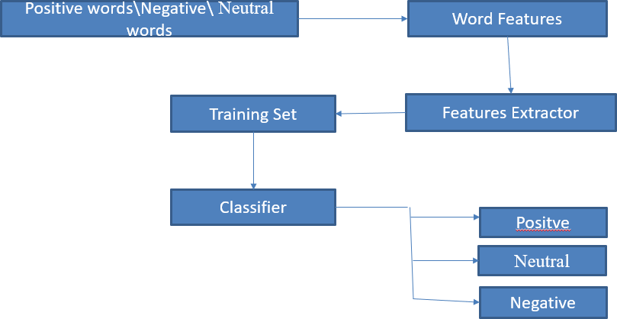
METHODOLOGY
Chapter 4
4.1 Architecture Diagram
Figure 4.1: Architecture Diagram of Opinion analysis using AI
The general architecture for opinion analysis solutions or even sequence based on natural language solutions the Figure 4.1 describes that to use movie reviews to build this sentiment analysis application. The goal of this application is to produce positive and negative reviews based on the input raw text.

Slide 23
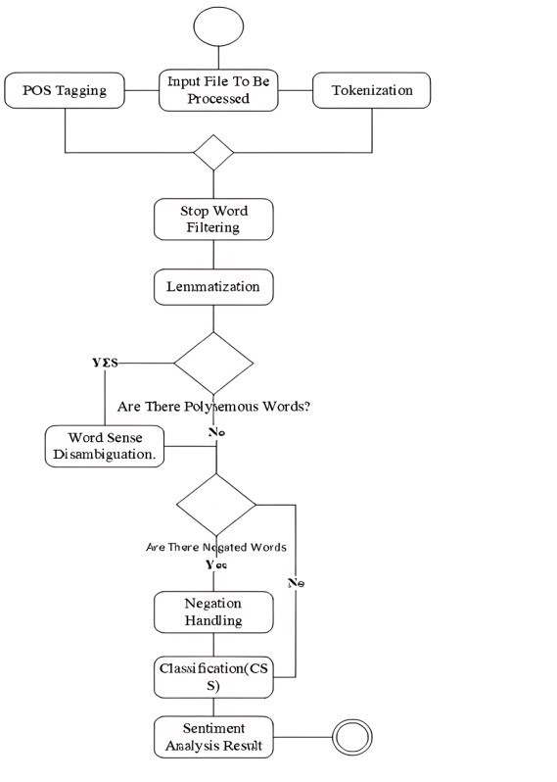
Design Phase
Activity Diagram
Figure 4.2: Activity Diagram of Opinion analysis using AI
In Figure 4.2, Activity diagram is another important diagram in UML to describe the dynamic aspects of the system. Activity diagram is basically a flowchart to represent the flow from one activity to another activity. The activity can be described as an operation of the system. From Figure 4.2, it shows the control flow is drawn from one operation to another. From start of data collection to till analysed data storage steps are explained in the activity diagram that is presented.

Slide 24
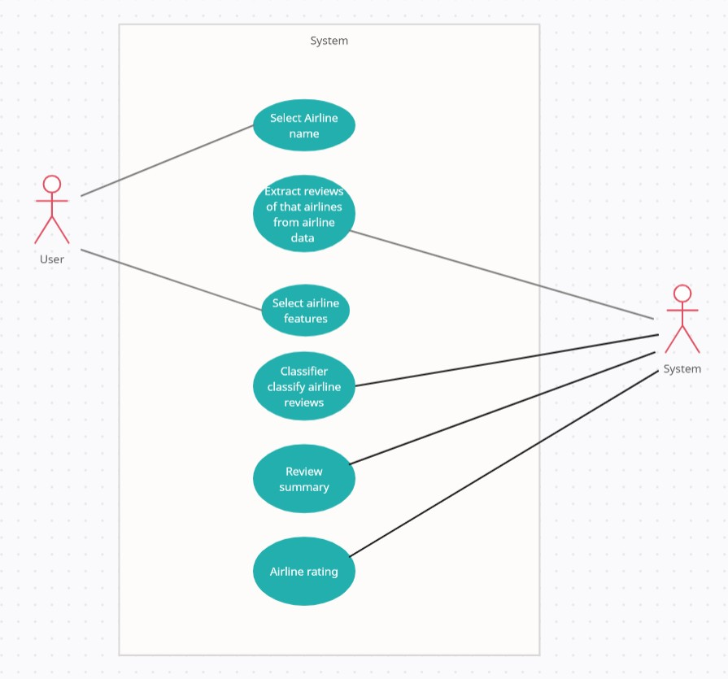
4.2.2 Use Case Diagram of Opinion analysis using AI
Figure 4.3: Usecase Diagram of Opinion analysis using AI
In Figure 4.3, The use case diagram of the project sentimental analysis using data mining is showing the relation and work that is done by users and admins in the project. For example, admin will collect the data and performs the sentimental anal- ysis then gives the output. Now the user will concatenate or remove the attributes as per their requirement.

Slide 25
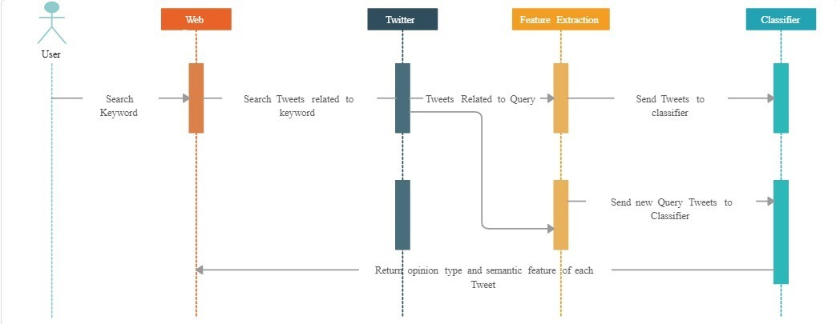
4.2.3 Sequence Diagram
Figure 4.4: Sequence Diagram of Opinion analysis using AI
In Figure 4.4, A sequence diagram or system sequence diagram(SSD) shows the process interactions arranged in time sequence in the field of software engineering. It depicts the processes involved and the sequence of messages exchanged between the processes needed to carry out the functionality. From Figure 4.4, it shows the process divided into understandable sub steps so that it can understand easily.
Algorithm & Pseudo Code
Algorithm
step 1: Start
step 2: Open Jupytor notebook or Google Colaboratory import the libraries step 3: Give the product reviews as input in csv file
step 4: Opinionative words or phrases

Slide 26
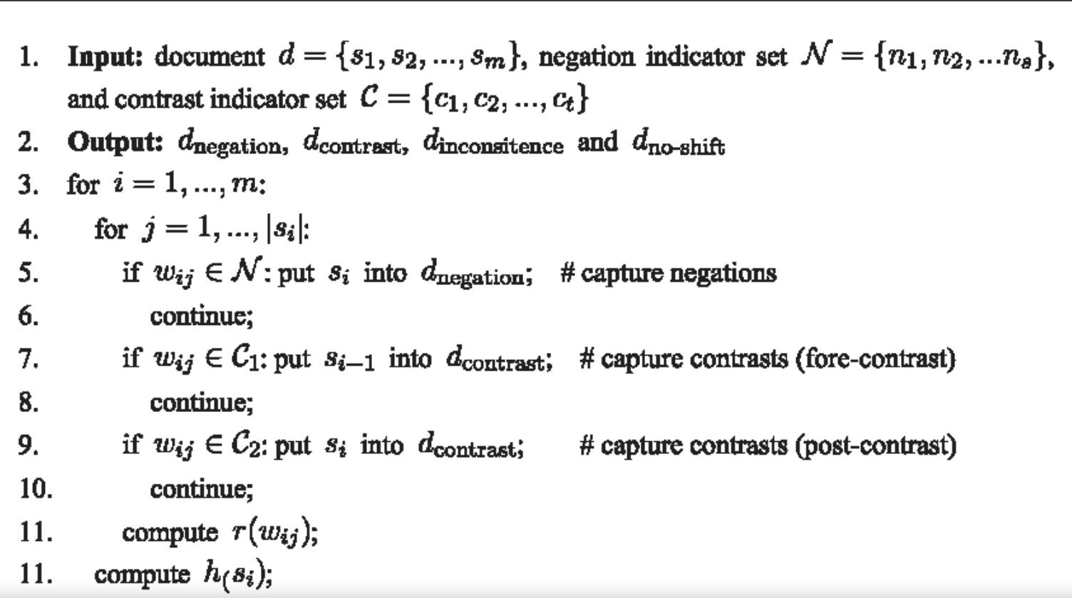
step 5: Feature selection step 6: Opinion analysis step 7: Stop
4.3.2 Pseudo Code
Module Description
The data collected on twitter, it has to do pre-processing for word features. Then using vectorizers. Feature vectors will be extracted. The features set will be trained and given to classifier for predictions. The classifier will produce the resultant for the categorized tweets. The data obtained after the Pre-processing, the Customer Feedback Analysis System will perform following activities.
Problem Identification
Problem Identification The phrases are identified manually after reading various re view comments for main categories namely Product Related and Support Related and few of them are selected. For each of the phrases, the associated words to identify the sub-issue under the main category are chosen. It is reduced by doing proper preprocessing in the initial phase. For Example, under Product Related Issues it has identified various functionality of the product along with phrases like Not-Working main problem.There is a very high possibility of getting junk words along with these phrases. It is reduced by doing proper pre-processing in the initial phase.

Slide 27
4.4.2 Text Classification
Text classification (SVM) are supervised learning models with associated learning algorithms that analyses data used for classification and regression analysis. In the addition to performing linear classification, SVMs can efficiently perform the non linear classification using what is called the kernel trick, implicitly mapping their inputs into high dimensional feature spaces.
Steps to execute/run/implement the project
Step1: Install the required tool
Open Google Colab
Write Code
4.5.2 Step2: Uplode required Dataset
Execute the code
Get output in word cloud and bargraph
4.5.3 Step3: Visuvalization of output
Analyse the output
Get knowledge

Slide 28
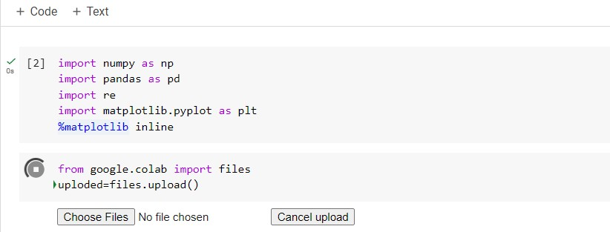
IMPLEMENTATION AND TESTING
Chapter 5
Input and Output
Input Design
Input Design plays a vital role in the life cycle of software development, it requires very careful attention of developers.The input design is to feed data to the application as accurate as possible. Input design is the process of converting the user created input into a computer-based format. The goal of the input design is to make the data entry logical and free from errors. So inputs are supposed to be designed effectively so that the errors occurring while feeding are minimized. According to Software Engineering Concepts, the input forms or screens are designed to provide to have a validation control over the input limit, range and other related validations. This often involves using the power of AI to analyze social data at scale, understand what’s being said in them, then extracting insights based on that information.The outcome is a numerical sentiment score for each phrase, usually on a scale of -1 (negative) to
+1 (positive) and 0 (neutral).
Figure 5.1: Input Design

Slide 29
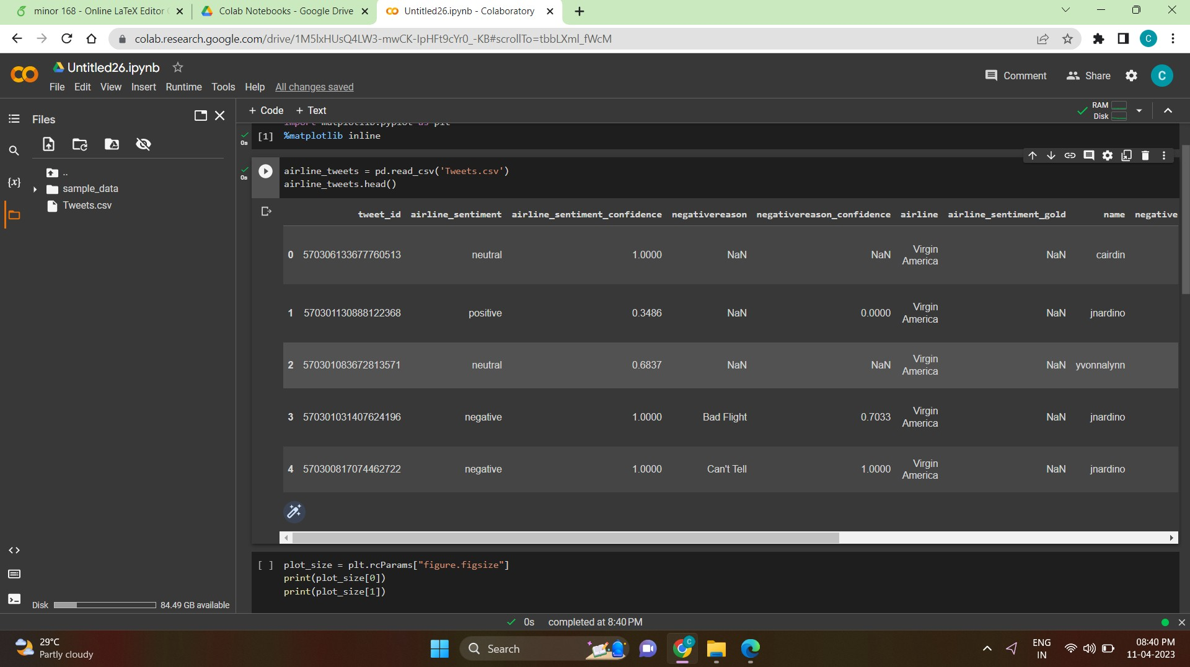
5.1.2 Output Design
The machine learning algorithms cannot read text format. So, the nlp techniques are used to convert text table into numpy array i.e., feature vectors will be going to ex- tracted those are understandable by machine and classifiers processes feature vectors resulting classification report, Confusion Matrix and Accuracy score. The confusion matrix is a table that is often used to describe the performance of a classification model on a set of test data for which the true values are known. It allows the visu- alization. It allows easy identification of confusion between classes e.g. one class is commonly mislabeled as the other. Classification report involves precision, recall, f1 score,support like metrics categorizing tweets as negative , neutral and positive.
Figure 5.2: Output Analysis
5.2 Testing
Testing is the process of evaluating a system or its components with the intent to find whether it satisfies the specified requirements or not.In simple words, testing is executing a system in order to identify any gaps, errors, or missing requirements in contrary to the actual requirements.The major objective of testing to check it is depended on all platforms and to check the compatibility. All projects should be

Slide 30
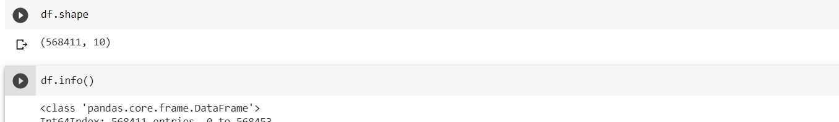
tested prior to the working of application.
Types of Testing
Unit testing
It is a level of software testing where individual units/ components of a software are tested. The purpose is to validate that each unit of the software performs as designed. A unit is the smallest testable part of any software. It usually has one or a few inputs and usually a single output. Unit testing means testing individual modules of an application in isolation (without any interaction with dependencies) to confirm that the code is doing things right.
Input
Figure 5.3: Input of opinion analysis using AI

Slide 31
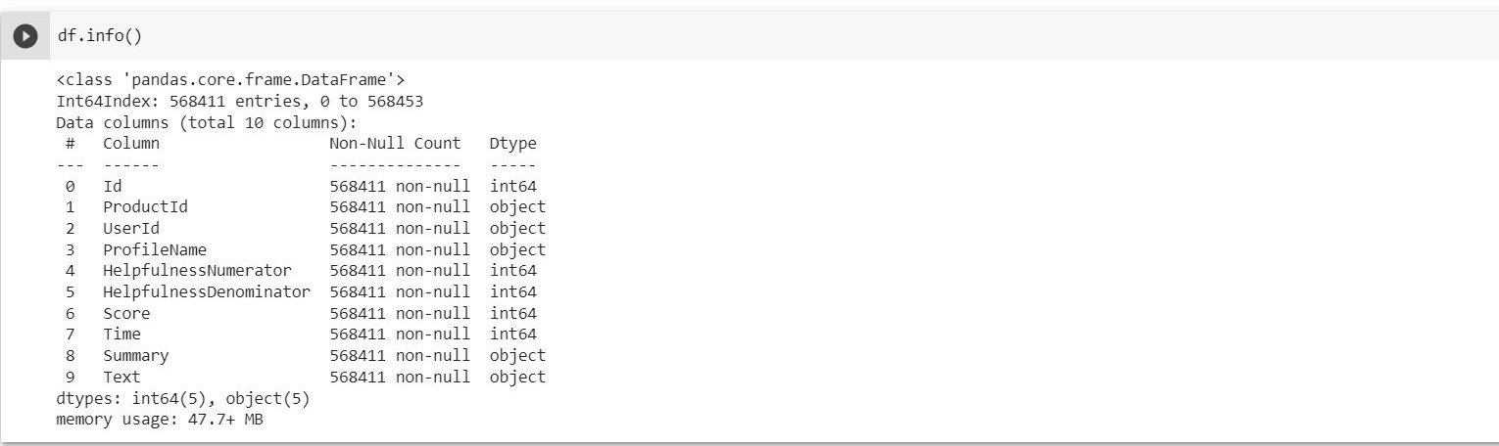
Test result
Figure 5.4: Output of opinion analysis using AI
5.3.2 Integration testing
It is a type of software testing in which the different units, modules or components of a software application are tested as a combined entity.It is a level of software testing where individual units are combined and tested as a group. The purpose of this level of testing is to expose faults in the interaction between integrated units. Test drivers and test stubs are used to assist in Integration Testing. Here, during preprocessing stage it has encountered some problems while executing BoW method because of Count vectorizer unable to embed with the code of TF-IDF vectorizer and later it has resolved it.

Slide 32
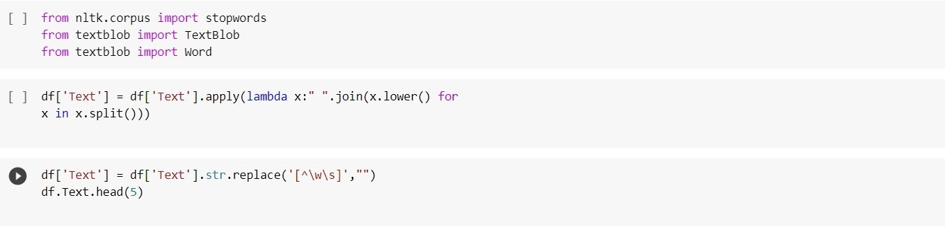
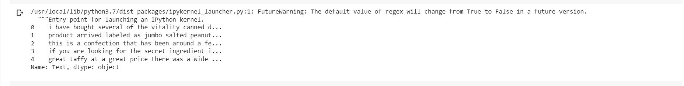
Figure 5.5: Integration testing input for airline
Figure 5.5 Describes the purpose of this level of testing is to expose faults in the interaction between integrated units and used to replace the text.
Test result
Figure 5.6: Integration testing output for airline tweets
Figure 5.6 Describes the preprocessing stage it has encountered some problems while executing BOW method because of Count vectorizer unable to embed with the code of TF-IDF vectorizer and later it has resolved it and used to replace the text as well as objects.

Slide 33
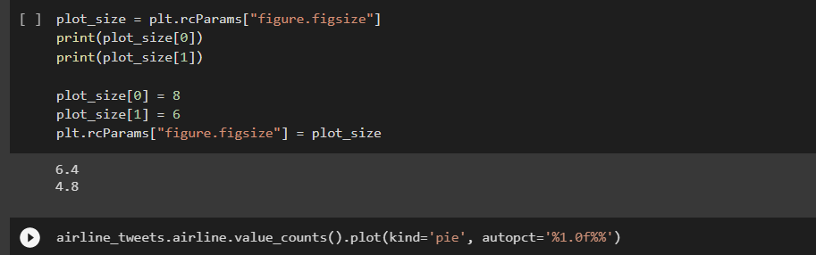
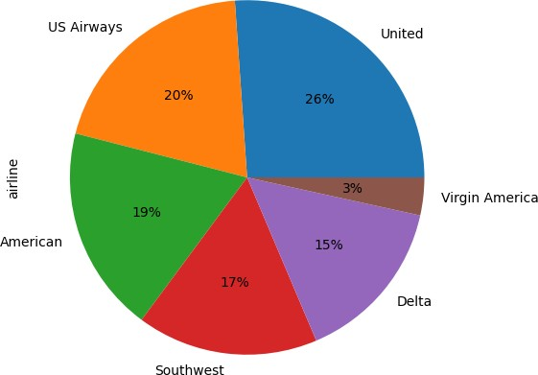
5.3.3 System testing
It is a software testing method in which tester does not know the internal structure or design of the item being tested. These tests can be functional or nonfunctional, though usually functional. In Black Box Testing, it just focus on inputs and output without bothering about internal knowledge. Here, Algorithms inner implementation is not known but it has calculated accuracy score and generated classification report for the provided dataset.
Figure 5.7: Implementation of system input
Test Result
Figure 5.8: Reviews for particular Airlines

Slide 34
RESULTS AND DISCUSSIONS
Chapter 6
Efficiency of the Proposed System
The proposed system is running in two phases. Training and Classification phases. The training phase in proposed system is going to build the classification model in order to distinguish between positive and negative tweets based on input labeled tweets collection. In the classification phase, the trained classification model will assign positive or negative label to the new unlabeled tweets. The results of algorithm will be represented in graphical manner. The proposed system is more effective than the existing one. This is because it will be able to know how the statistics determined from the representation of the result can have an impact in a particular field.
Comparison of Existing and Proposed System Existing system
Existing System does not give more weightage to less occurred words which have much impact as it creates numpy array by using decision tree.
The precision of negative, neutral. positive tweets are 0.79,0.60,0.76
Accuracy score of existing system is 87.990%
Proposed System
Proposed System gives importance to words occurred less in document by cre- ating vector array by using SVM classification.
The precision of negative, neutral. positive tweets are 0.82.0.62.0.76
Accuracy score of proposed system is 94.60%

Slide 35
Advantages of the Proposed System
SVM’s are very good when it has no idea on the data.
Works well with even unstructured and semi structured data like text, Images and trees.
The kernel trick is real strength of SVM. With an appropriate kernel function, it can solve any complex problem.
SVM models have generalization in practice, the risk of over-fitting is less in SVM.
TF-IDF returns documents that are highly relevant to a particular query. TF-IDF is also not a very big challenge, thus making it ideal for form.
6.3 Sample Code
1 i m p o r t numpy as np
2 i m p o r t pandas as pd
3 i m p o r t m a t p l o t l i b . p y p l o t as p l t
4 i m p o r t s e a b o r n as s n s
5 df a i r l i n e =pd . r e a d c s v ( . . / i n p u t / t w i t t e r airlinesentiment / Tweets . c s v )
6 d f a i r l i n e . shape
7 d f a i r l i n e . columns
8 d f a i r l i n e . head ( )
9 d e f g e t p e r c n u l l ( df ) :
10 r e s ={}
11 f o r c o l i n df . columns :
12 p e r c = round ( df [ c o l ] . i s n u l l ( ) . sum ( ) * 100 / l e n ( df ) , 2 )
13 r e s [ c o l ] = p e r c
14 r e t u r n r e s
15 g e t p e r c n u l l ( d f a i r l i n e )
16 d f a i r l i n e = d f a i r l i n e . drop ( [ ’ tweet id ’ , negativereason ,
airline sentiment gold , negative r e a s o n c o n f i d e n c e ,
tweet coord
,
17
tweet location , user t i m e z o n e ,
retweet count , name , tweet created
18
,
19 n e g a t i v e r e a s o n g o l d ] , a x i s = 1 )
20 d f a i r l i n e . shape
21 d f a i r l i n e
22 p l t . f i g u r e ( f i g s i z e = ( 1 0 , 8 ) )
23 s n s . c o u n t p l o t ( df a i r l i n e [ airline ] )

Slide 36
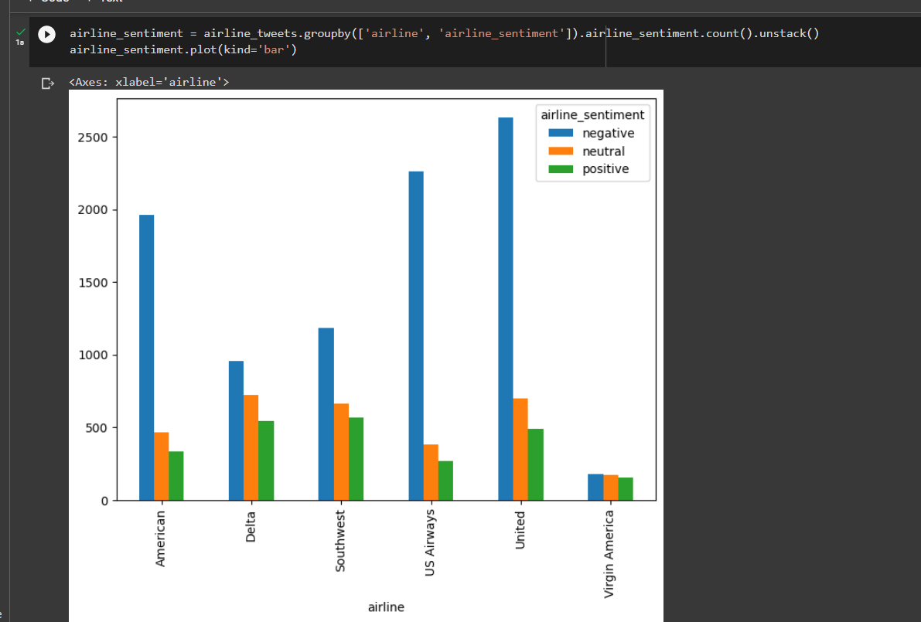
Output
Figure 6.1: Shows the Airline Reviews
Figure 6.1 describe the sentiment analysis job about the problems of each major
U.S. airline. Twitter data was scraped from February of 2015 and contributors were asked to first classify positive, negative, and neutral tweets, followed by categorizing negative reasons (such as late flight or rude service). we can see that United, US Airways and American have substantially negative tweets, these also have got over all more tweets. Virgin America, Delta and Southwest have fairly balanced tweets.

Slide 37
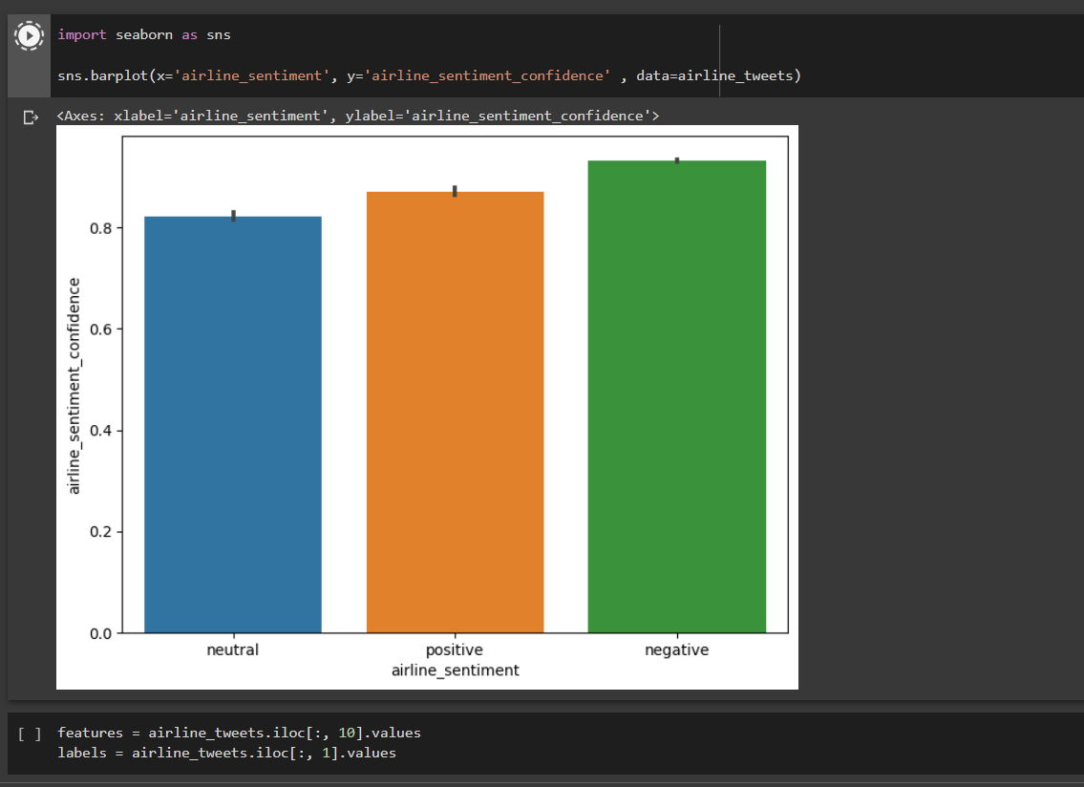
Figure 6.2: Sentiments analysis report
Figure 6.2 describes the sentence level in which polarity of sentence can be given by three categories as positive, negative and neutral. About 60% of the reported senti- ments were negative. I therefore focus primarily on negative comments. I next inves- tigate how the sentiments vary across airlines. United had the most number of tweets, followed by US airways and American airlines United, US airways and American airlines have higher proportions of negative comments. Whereas, Soutwest, Delta and Virgin America had lower proportion of negative comments. Two main reasons for negative comments were customer service issues and late flights. US Airways had the highest proportion of negative tweets due to customer servce issues. The main reason for negative comments was customer service issue.

Slide 38
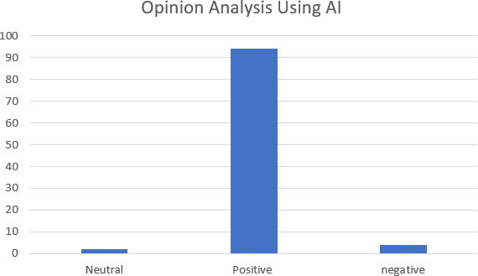
Figure 6.3: Performance of Opinion analysis
Figure 6.3 describes the accuracy level of opinion analysis and performance eval- uation, two statistical measures were used, including the accuracy and specificity. Sensitivity represents the probability of correctly identifying the True Positive class, Y means ‘Yes’, while specificity represents the probability of correctly identifying the True Negative class, and here Y means ‘No’. If the model predicts a class as negative, while the actual class is positive, we define it as False Negative. On the contrary, if the model predicts a class as positive, while the actual class is negative, we define it as False Positive. Overall, the accuracy measures the probability of detecting the true class is 94.60%.

Slide 39
CONCLUSION AND FUTURE ENHANCEMENTS
Chapter 7
Conclusion
Opinion analysis has become an important factor in decision making process in a particular field. In this project, we discussed techniques for pre-processing and also we studied about the supervised learning technique: Support Vector Machine for text categorization which can be used to find out the polarity of textual tweet. In supervised learning methods, it adopts set of words. This approach assumes that every single word in the test data is repeated at least once, which eliminates the zero probability problem. After applying this approach, the results are obtained correctly and their execution is also very fast.
Future Enhancements
As a future work, it may include the “neutral” tweets into the proposed system by adapting the feature extraction and the classification steps to recognize these tweets efficiently. Neural networks will give better results than SVM even though hard to implement on every system.Artificial intelligence helps the social media marketers to create more effective social campaigns and be more efficient with their use of time. According to a research by scientists at the University of Oxford, Artificial In- telligence will be better than humans at translating languages, writing school essays, selling goods, write a bestselling book and conducting surgeries.

Slide 40
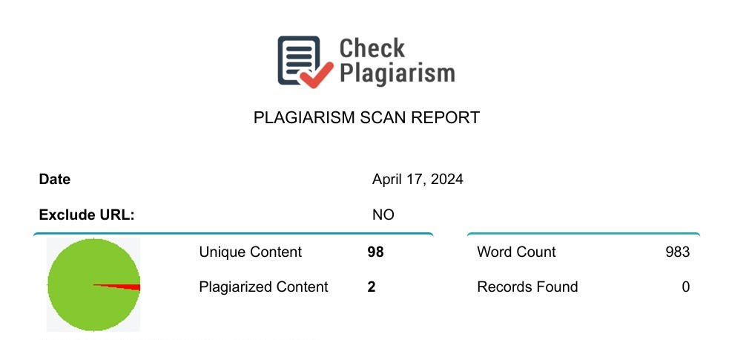
PLAGIARISM REPORT
Chapter 8
Figure 8.1: Plagiarism report

Slide 41
SOURCE CODE & POSTER PRESENTATION
Chapter 9
9.1 Source Code
1 i m p o r t numpy as np
2 i m p o r t pandas as pd
3 i m p o r t m a t p l o t l i b . p y p l o t as p l t
4 # m a t p l o t l i b i n l i n e f r o m g o o g l e . c o l a b i m p o r t f i l e s u p l o a d e d = f i l e s . u p l o a d ( )
5 df = pd . r e a d c s v ( ’ Reviews . csv ’ )
6 df
7 df
8 df
9 df
10 df
. head ( )
. shape
. i n f o ( )
. Summary . head ( )
. Text . head ( )
11 ! p i p i n s t a l l t e x t b l o b
12 from n l t k . c o r p u s i m p o r t s t o p w o r d s
13 from t e x t b l o b i m p o r t Text Blob
14 from t e x t b l o b i m p o r t Word
15 df [ ’ Text ’ ] = df [ ’ Text ’ ] . a p p l y ( lambda x : ” ” . j o i n ( x . lower ( ) f o r
16 x i n x . s p l i t ( ) ) )
17 df [ ’ Text ’ ] = df [ ’ Text ’ ] . s t r . r e p l a c e ( ’ [ ˆ \w\ s ] ’ , ” ” )
18 df . Text . head ( 5 )
19 s t o p = s t o p w o r d s . words ( ’ e n g l i s h ’ )
20 df [ ’ Text ’ ] = df [ ’ Text ’ ] . a p p l y ( lambda x : ” ” . j o i n ( x f o r x i n
21 x . s p l i t ( ) i f x n o t i n s t o p ) )
22 df . Text . head ( )
23 s t o p = s t o p w o r d s . words ( ’ e n g l i s h ’ )
24 df [ ’ Text ’ ] = df [ ’ Text ’ ] . a p p l y ( lambda x : ” ” . j o i n ( x f o r x i n
25 x . s p l i t ( ) i f x n o t i n s t o p ) )
26 df . Text . head ( )
27 # Le m ma t i z a t i on
28 df [ ’ Text ’ ] = df [ ’ Text ’ ] . a p p l y ( lambda x : ” ” . j o i n ( [ Word ( word ) .
29 l emmatize ( ) f o r word i n x . s p l i t ( ) ] ) )
30 df . Text . head ( )
31 ! p i p i n s t a l l wordcloud
32 from wordcloud i m p o r t WordCloud
33 from wordcloud i m p o r t STOPWORDS
34 # C r e a t e a new d a t a f rame ” r e v i e w s ” t o perform e x p l o r a t o r y d a t a
35 r e v i e w s = df
a n a l y s i s upon t h a t

Slide 42
36 # Dropping n u l l v a l u e s
37 r e v i e w s . dropna ( i n p l a c e =True )
38 s c o r e 1 = r e v i e w s [ r e v i e w s [ ’ Score ’ ] == 1 ]
39 s c o r e 2 = r e v i e w s [ r e v i e w s [ ’ Score ’ ] == 2 ]
40 s c o r e 3 = r e v i e w s [ r e v i e w s [ ’ Score ’ ] == 3 ]
41 s c o r e 4 = r e v i e w s [ r e v i e w s [ ’ Score ’ ] == 4 ]
42 s c o r e 5 = r e v i e w s [ r e v i e w s [ ’ Score ’ ] == 5 ]
43 r e v i e w s sample = pd . c o n c a t ( [ s c o r e 1 , s c o r e 2 , s c o r e 3 , s c o r e 4 , s c o r e 5 ] , a x i s = 0 )
44 r e v i e w s sample . r e s e t i n d e x ( drop =True , i n p l a c e =True )
45 # Wordcloud f u n c t i o n ’ s i n p u t needs t o be a s i n g l e s t r i n g of t e x t .
46 # c o n c a t e n a t i n g a l l Summaries i n t o a s i n g l e s t r i n g .
47 # s i m i l a r l y you can b u i l d f o r Text column
48 r e v i e w s s t r = r e v i e w s s a m p l e . Summary . s t r . c a t ( )
49 wordcloud = WordCloud ( b a c k g r o u n d c o l o r = ’ w h i t e ’ ) . g e n e r a t e ( r e v i e w s s t r )
50 p l t . f i g u r e ( f i g s i z e = ( 1 0 , 1 0 ) )
51 p l t . imshow ( wordcloud , i n t e r p o l a t i o n = ’ b i l i n e a r ’ )
52 p l t . a x i s ( ” o f f ” )
53 p l t . show ( )
54 # Now l e t ’ s s p l i t t h e d a t a i n t o N e g a t i v e ( Score i s 1 or 2 ) and P o s i t i v e ( 4 or # 5 ) Reviews .
55 n e g a t i v e r e v i e w s = r e v i e w s s a m p l e [ r e v i e w s s a m p l e [ ’ Score ’ ] . i s i n ( [ 1 , 2 ] ) ]
56 p o s i t i v e r e v i e w s = r e v i e w s s a m p l e [ r e v i e w s s a m p l e [ ’ Score ’ ] . i s i n ( [ 4 , 5 ] ) ]
57 # Transform t o s i n g l e s t r i n g
58 n e g a t i v e r e v i e w s s t r = n e g a t i v e r e v i e w s . Summary . s t r . c a t ( )
59 p o s i t i v e r e v i e w s s t r = p o s i t i v e r e v i e w s . Summary . s t r . c a t ( )
60 w o r d c l o u d n e g a t i v e = WordCloud ( b a c k g r o u n d c o l o r = ’ w h i t e ’ ) . g e n e r a t e ( n e g a t i v e r e v i e w s s t r )
61 w o r d c l o u d p o s i t i v e = WordCloud ( b a c k g r o u n d c o l o r = ’ b l a c k ’ ) . g e n e r a t e ( p o s i t i v e r e v i e w s s t r )
62 # P l o t
63 f i g = p l t . f i g u r e ( f i g s i z e = ( 1 0 , 1 0 ) )
64 ax1 = f i g . a d d s u b p l o t ( 2 1 1 )
65 ax1 . imshow ( w o r d c l o u d n e g a t i v e , i n t e r p o l a t i o n = ’ b i l i n e a r ’ )
66 ax1 . a x i s ( ” o f f ” )
67 ax1 . s e t t i t l e ( ’ Reviews wi t h N e g a t i v e S c o r e s ’ , f o n t s i z e = 20 )
68 f i g = p l t . f i g u r e ( f i g s i z e = ( 1 0 , 1 0 ) )
69 ax2 = f i g . a d d s u b p l o t ( 2 1 2 )
70 ax2 . imshow ( w o r d c l o u d p o s i t i v e , i n t e r p o l a t i o n = ’ b i l i n e a r ’ )
71 ax2 . a x i s ( ” o f f ” )
72 ax2 . s e t t i t l e ( ’ Reviews wi t h P o s i t i v e S c o r e s ’ , f o n t s i z e = 20 )
73 p l t . show ( )
74 ! p i p i n s t a l l v a d e r S e n t i m e n t
75 i m p o r t r e
76 i m p o r t os
77 i m p o r t s y s
78 i m p o r t a s t
79 p l t . s t y l e . use ( ’ f i v e t h i r t y e i g h t ’ )
80 # F u n c t i o n f o r g e t t i n g t h e s e n t i m e n t
81 # cp = s . c o l o r p a l e t t e ( )
82 from v a d e r S e n t i m e n t . v a d e r S e n t i m e n t i m p o r t S e n t i m e n t I n t e n s i t y A n a l y z e r
83 a n a l y z e r = S e n t i m e n t I n t e n s i t y A n a l y z e r ( )
84 # G e n e r a t i n g s e n t i m e n t f o r a l l t h e s e n t e n c e p r e s e n t i n t h e d a t a s e t
85 e m p t y l i n e =[ ]

Slide 43
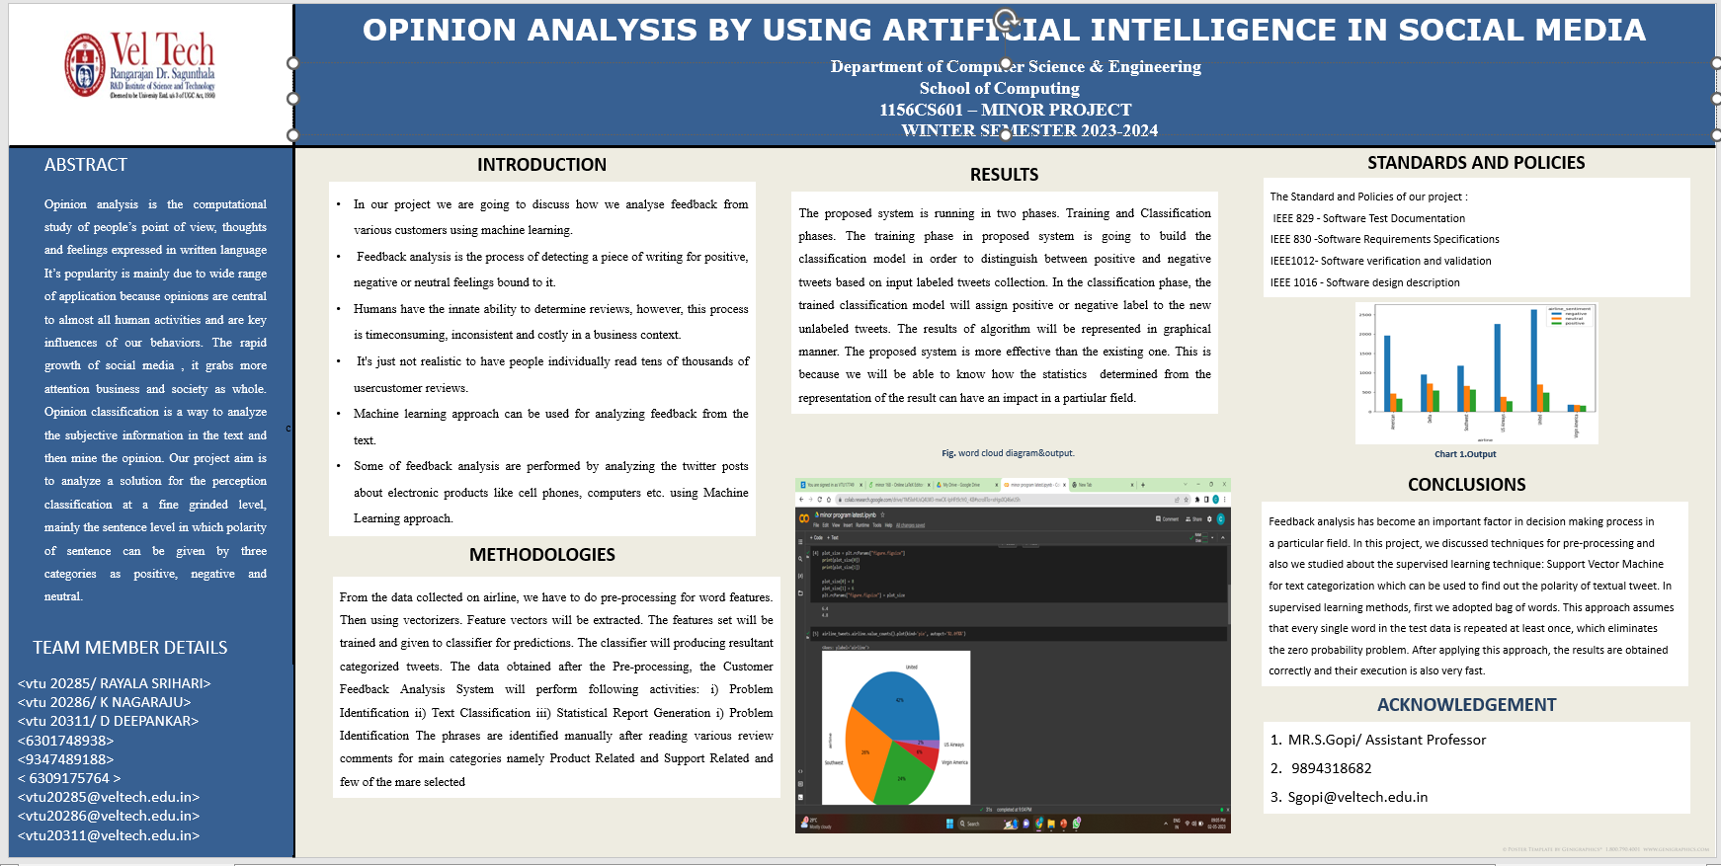
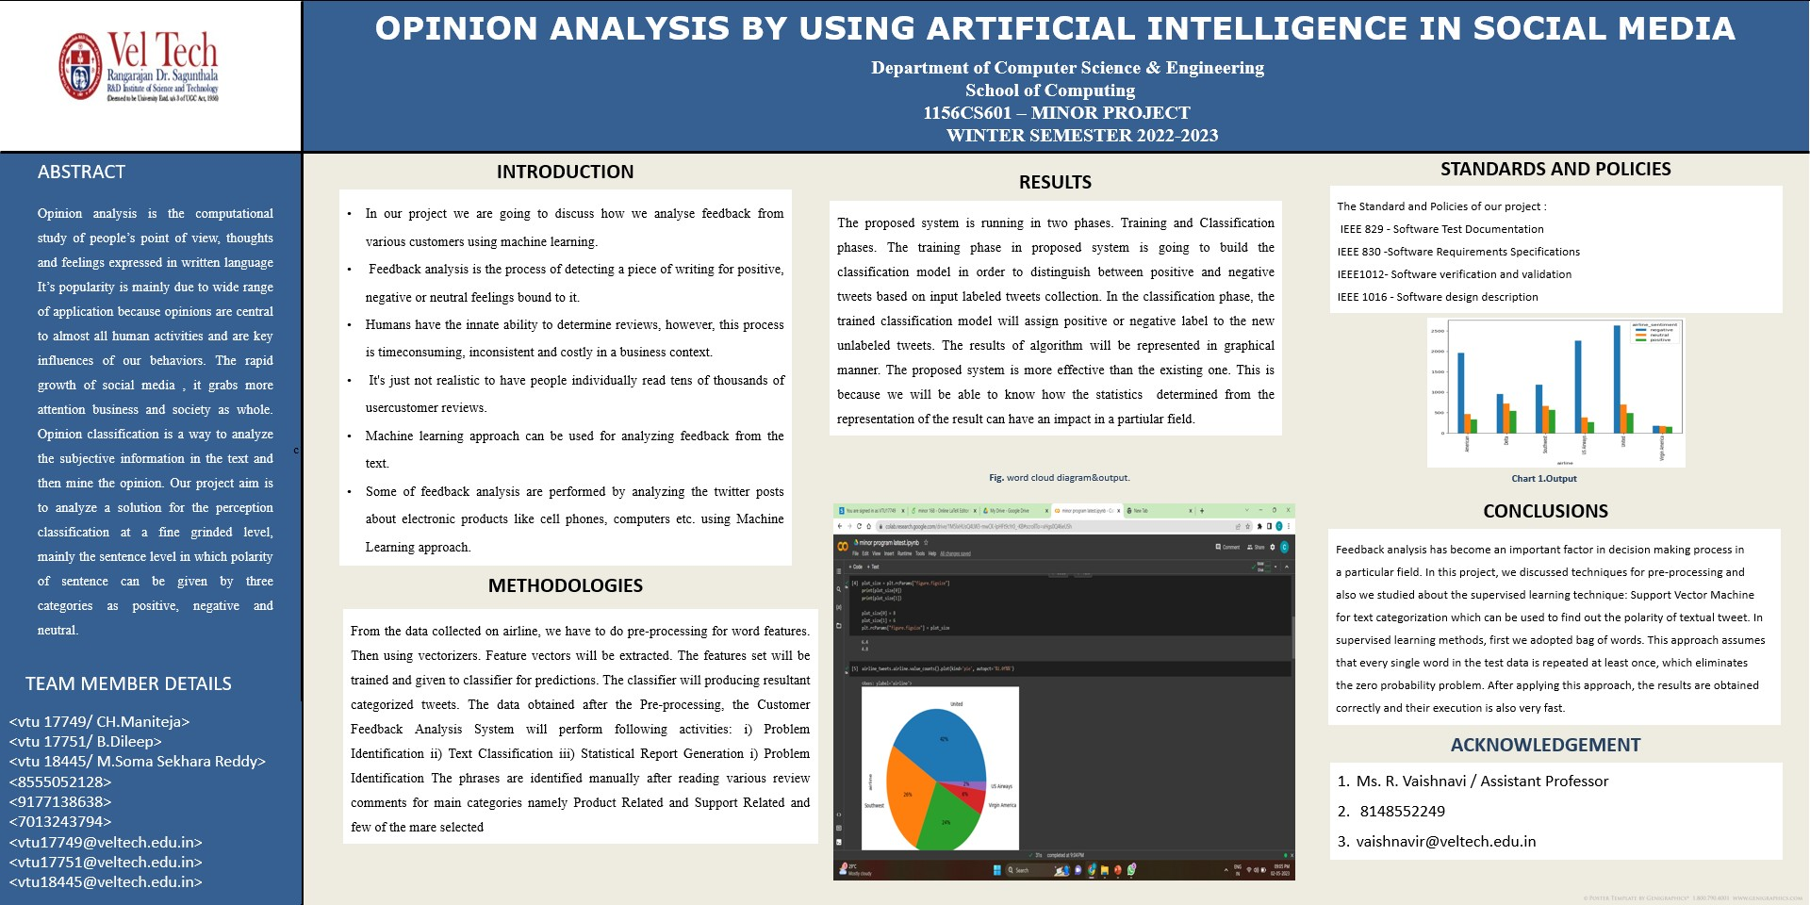
86 f o r row i n df [ ’ Text ’ ] :
87 vs= a n a l y z e r . p o l a r i t y s c o r e s ( row )
88 e m p t y l i n e . append ( vs )
89 # C r e a t i n g new d a t a f r a m e wit h s e n t i m e n t s
90 df s e n t i m e n t s =pd . Data Frame ( e m p t y l i n e )
91 df s e n t i m e n t s . head ( )
92 # Merging t h e s e n t i m e n t s back t o r e v i e w s d a t a f r a m e
93 df c =pd . c o n c a t ( [ df . r e s e t i n d e x ( drop =True ) , df s e n t i m e n t s ] , a x i s = 1 )
94 df c . head ( 3 )
95 # Convert s c o r e s i n t o p o s i t i v e and n e g e t i v e s e n t i m e n t s u s i n g some t h r e s h o l d
96 d f c [ ’ S e n t i m e n t ’ ] = np . where ( d f c [ ’ compound ’ ] >= 0 , ’ P o s i t i v e ’ , ’ N e g a t i v e ’ )
97 d f c . head ( 5 )
98 from g o o g l e . c o l a b i m p o r t d r i v e
99 d r i v e . mount ( ’ / c o n t e n t / d r i v e ’ )
100 r e s u l t = d f c [ ’ S e n t i m e n t ’ ] . v a l u e c o u n t s ( )
101 r e s u l t . p l o t ( k i n d = ’ b a r ’ , r o t = 0 , c o l o r =[ ’ plum ’ , ’ cyan ’ ] ) ;
9.2 Poster Presentation
Figure 9.1: Poster Presentation

Slide 44
References
Aameen Khowaja, Mumtaz Hussain Mahar, Haque Nawaz1, ShaukatWasi, Shafiq-urRehman, “Personality Evaluation of Student Community using the Sen- timent Analysis”, (2021), IJCSNS International Journal of Computer Science and Network Security, Volume 04, Issue 06.
Azhar Imran, Muhammad Faiyaz, Faheem Akhta, “An Enhanced Approach for Quantitative Prediction of Personality in Facebook Posts”, (2020), IEEE, Volume 03, Issue 05
Ali Yadollahi, Ameneh Gholipour Shahraki, Osmar R. Za¨ıane “Current State of Text Sentiment Analysis from Opinion to Emotion Mining”, (2020), ACM Computer Survey.
A. K. Uysal, S. Gunal, ”The impact of preprocessing on text classification”, (2019), An Information Processing Management.
B.Gokulkrishnan, P. Priyanthan, T. Ragavan, N. Prasath and A. Perera. ”Opin- ion Mining and Sentiment Analysis on a Twitter Data Stream”, (2022), IEEE, Volume 02, Issue 04.
Geetika Gautam, Divakar Yadav. ”Sentiment Analysis of Twitter Data Using the Machine Learning Approaches and Semantic Analysis”, (2020), IEEE, Volume 02, Issue 02.
Hung T.Vo, Hai C.Lam, Duc Dung Nguyen, Nguyen Huynh,” The Vietnamese Education Survey System, Asian Journal of Computer Science and Information Technology”, (2019), IJNS International Journal of Network Security.
Medhat Walaa, Ahmed Hassan, Hoda Korashy, ”Sentiment analysis algorithms and applications: A survey”, (2022), Ain Shams Engineering Journal.
RuiZhao and Kezhi Mao, “ Fuzzy Bag-of-Words Model are for the Document Representation ”, (2022), Journal of latex class files ,vol. 14, no. 8.
Soumi Sarkar, Taniya Seal, “Sentiment Analysis An Objective View”,(2019), Journal of Research, Volume 02, Issue 02.

